Slide 1
Where do SEPTA BUS TRIP Cancelations OCCUR?
Will Friedrichs Data Presentation 2-11-22

Slide 2
Why Study Cancelations?
Growing Google Maps Usership for public transportation
Google Maps “untracked cancelation” phenomenon
SEPTA App
Google Maps App

Slide 3



Source of the issue
SEPTA puts out public information in the form of a constant GTFS real-time data stream
Google Maps needs GTFS data output
This tracks delays, detours, and other real-time changes, but not cancellations
Real-time cancellations only reported directly from TransitView
SEPTA
TransitView
GTFS
real-time

Slide 4
Transit view (Buses)
2,000 - 3,000 updates visible at any given time
For all buses in SEPTA system, shows:
bus positions
delay statuses
trip identification
timestamps
etc.
"lat":"40.022942",
"lng":"-75.078666999999996",
"label":"7445",
"VehicleID":"7445",
"BlockID":"1055",“
Direction":"SouthBound",
"destination":"Frankford Transportation Center",
"Offset":"1",
"heading":180,
"late":0,
"original_late":-3,
"Offset_sec":"21",
"trip":"670961",
"next_stop_id":null,
"next_stop_name":null,
"next_stop_sequence":null,
"estimated_seat_availability":"NOT_AVAILABLE",
"timestamp":1644579125}, =

Slide 5
Python program
Current implementation
Logs each update every two minutes across the system
Records delays if there are any at 2,000 – 3,000 stops, repeats every two minutes
Future implementation
Virtual Private Server service
Ideally, program would run for several weeks uninterrupted

Slide 6
Testing the program
Test period: 2 hours
Tuesday, Feb 8 from 8:38 PM - 10:38 PM
2,312 evaluations of planned bus pickups
110 cancellations: 4.8% of all pickups over the 2 hr period
Routes affected:
26
64
104
117
120

Slide 7
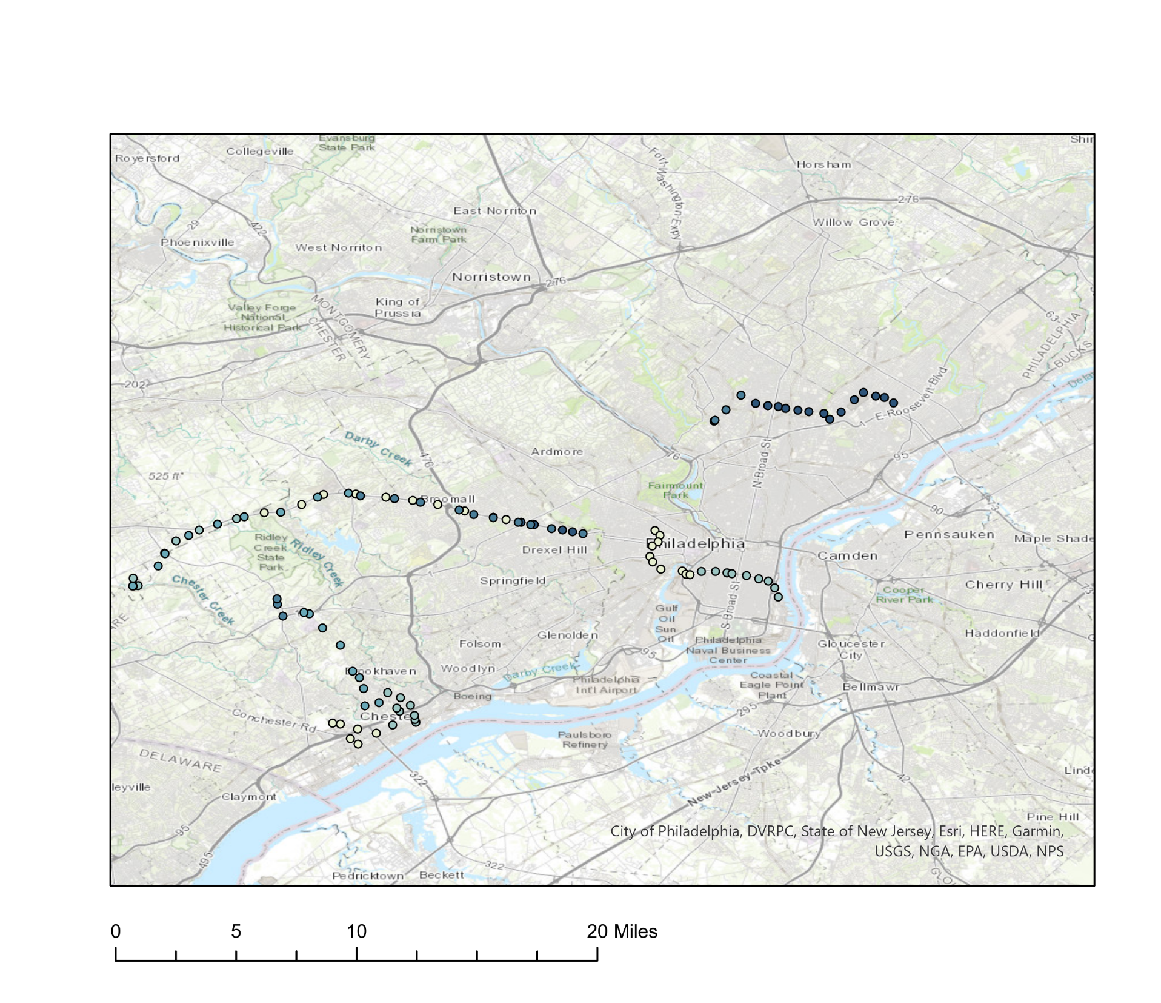

Testing the program: Map 1
Cancellation Time
8:38 PM
9:38 PM
10:38 PM

Slide 8
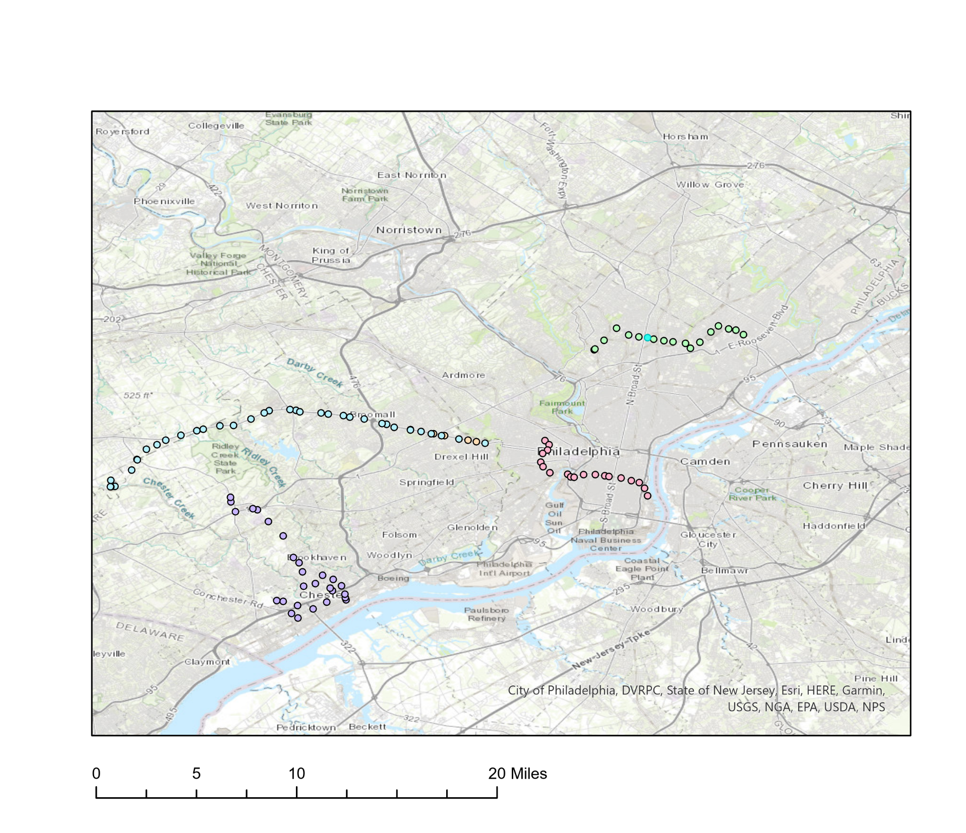
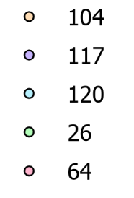
Testing the program: Map 2
Bus Route

Slide 9
With more data…
Plans to track:
Bus cancellations versus demographic information
Ridership by population
Transit use
Car ownership
Bus cancellations by time of day
Bus cancellations by day of the week
Impact of specific events
E.g. snowstorm, etc.

